Slide 1
Video Game Strategy Inference Given Partial Observability using Probability Density Functions
Michael Kozak

Slide 2
Agenda
Topic | Duration
Thesis Overview | 3
Background | 10
StarCraft
Probability Density Functions
Strategy Representation
IRE and Strategy Inference | 10
Experimental Design | 5
Setup
Results
Conclusion | 2

Slide 3
Overview

Slide 4
Objectives
Develop an intent recognition engine that, given partial observability of enemy forces, can build a probabilistic representation of what their overall capabilities are.
Compare that “belief state” against known strategies to determine if the enemy is using a particular one.
Apply a counter-strategy and show improvement in win rate

Slide 5
Who cares?
Intent recognition next step of autonomous operations as current planning systems reach high maturity
Partial observability is a reality of many operational domains
Adversarial AI extends beyond physical into cyber
Benefits any program with potential for dealing with adversarial OR where autonomy is expected to reason without complete knowledge

Slide 6
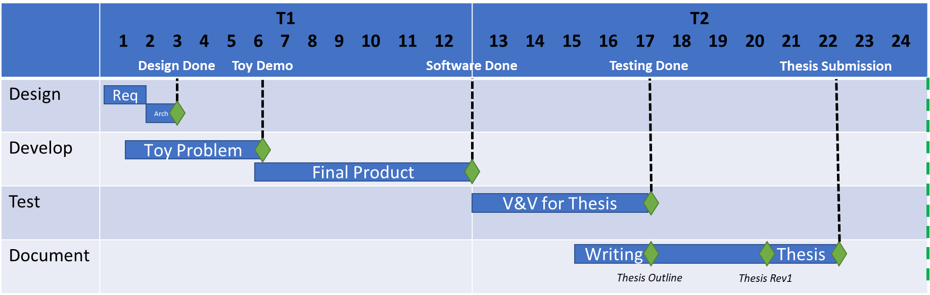
Schedule

Slide 7
Risks/Mitigation
Risk | Risk Mitigation
Strategies don’t map easily to coordinate axes chosen | Place unusual strategies in region that results in “common” counter-strategy
Learning proves too time consuming due to length of games and number required for dataset | Professor (Dr. Santiago Ontañón) has render farm I can outsource to
Win rate does not improve | N/A – may require better learning to be more effective
Success would demonstrate the benefits of strategy inference in partial observability and provide a software “nugget” for winning adversarial AI programs

Slide 8
Background

Slide 9
StarCraft

Slide 10
Starcraft for AI
Real-Time Strategy Game considered a frontier of AI research
Players can choose from 1 of 3 races with unique buildings, units, and upgrades.
Branching factor for unit decisions is between 10^50 - 10^200
Players can only see what their units see, creating a partially observable enemy state
Notes:
Chess branching factor is 30^80

Slide 11
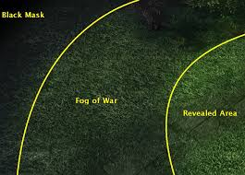
Fog of War
The revealed area is the union of all the sight ranges of all your units and buildings.
Previously viewed terrain and buildings within fog remain visible, but do not refresh state.
Never before viewed segments remains black until explored.

Slide 12
State of the Art
Yearly 1v1 AIIDE StarCraft AI competition (generally) between universities.
Player skill ranked by iCCup2 ladder as E through A+
The best AI bots rank between D and D+
AI rely on a wide range of different techniques:
Some of the most effective have hard-coded “rush” strategies
Some rely on micro-managing unit control or deep learning
“Nova” uses a tiered system of base management and squad control with relatively simple unit AI
Partial observability is often ignored in favor of reacting to the moment
Counter-strategies therefore rely on reacting rather to than predicting situations

Slide 13
Example Architectures

Slide 14
Probability Density Functions

Slide 15
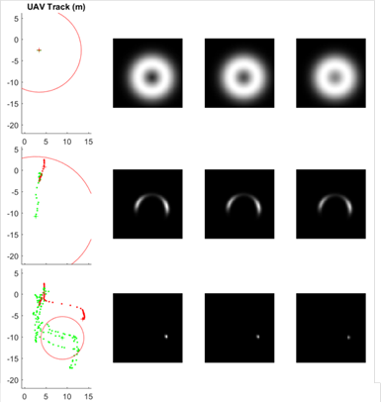
Discrete Probability Densities
PDF
DPD
Each measurement creates an error bound on the position estimate. As these error bounds are layered on top of each other the real position rises to the top

Slide 16
Strategy Representation

Slide 17
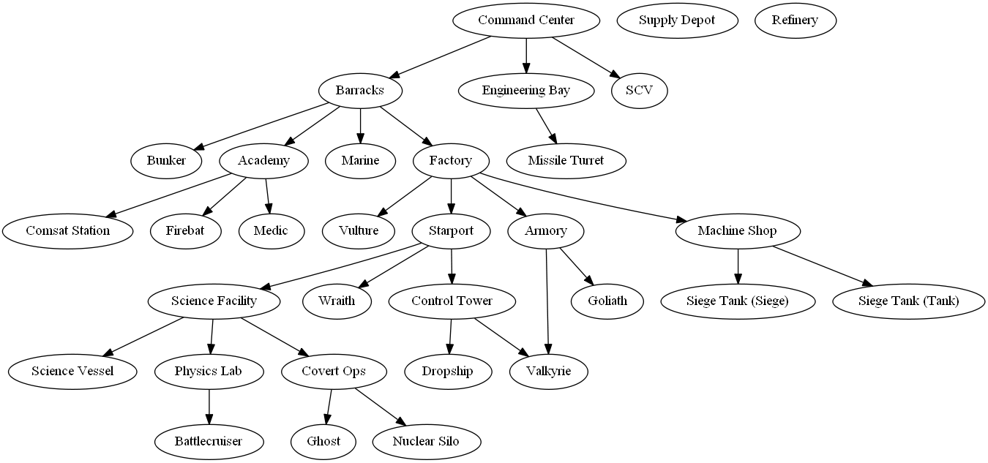
Terran Tech Tree

Slide 18
Tech Tree Representation
Edge weight increase with each unit spotted
Learned?

Slide 19
Strategy Templating
Strategies exist as templated subgraphs representing the unique paths taken in upgrade choices
“Vulture Rush”
“Marine Rush”
Notes:
AI profiles with unique weights based on observed habits

Slide 20
“Strategy Space”
18 Strategies identified by research as most common “build orders”
Lay out all strategies into a single supergraph and let the PDF additive process downselect to strategy leaf nodes for “localizing” on approach

Slide 21
“Strategy Space”
Ground Reliance
Defensive
Air Reliance
Anti-Air Reliance
Anti-Ground Reliance
Aggressive

Slide 22
IRE and Strategy Inference

Slide 23
Novel Approach
Combine Probability Density Function (PDF) process with Tech Trees to create “strategy space” for possible enemy strategies
Use observations to strengthen nodes/edges in tree with multiplicative effect
Over time, the highest peaks will identify regions in “strategy space” where the enemy is most concentrated
While strategies are still being formed, Nova can act based on what region/quadrant has the largest average height

Slide 24
Requirements
Blueforce – Player or Allied army
Redforce – hostile player
Capability - unit, building, or upgrade
Research – upgrades of unit or building capabilities purchased through an already built building
Strategy – A discrete collection of Capabilities in particular ratios designed to gain dominance over an opposing player with a bias towards land, hybrid, or air combat
ID | Requirement | Test Method
01 | The system shall represent the relationships and dependencies between units, buildings, and upgrades | Visual
02 | The system shall, given a Capability, determine what must be built or researched and what could be built or researched relative to other units, buildings, and upgrades | Automated
03 | The system shall, given a partial view of an enemy base, determine what must be built or researched and what could be built or researched relative to other units, buildings, and upgrades | Automated
04 | The system shall maintain a set of coarse strategies based on common play styles | Visual
05 | The system, given a representation of redforce Capabilities, suggest a strategy that the redforce is using | Automated
06 | The system shall, given multiple of a Capability detected, adjust the probability of each possible strategy | Automated
07 | The system shall, given ground truth and a predicted strategy, update the probabilities for the strategy based on Capability overlap | Automated

Slide 25

Use Case
StarCraft
BWAPI
NOVA
Intent Recognition Engine (IRE)
ID Enemy Strategy
Strategies
Propose Counter-Strategy
Evaluator
Read and Write Strategies

Slide 26
Architecture
PDDL Reader
Capability
Status
PDDL File
Test Driver
StarCraft
Game Interface
(BWAPI)
Strategy Reader
Strategies
Inference Engine
Update Template Weights
Tree Builder

Slide 27
“Strategy Space Convergence”
As observations are laid on top of the strategy space, regions outside a “common strategy” will converge on which strategy is being used
This also allows early counter-strategies as observations result in the enemy trending into “aggressive”, “defensive”, “ground”, and “air” quadrants without waiting to see the full enemy strategy

Slide 28
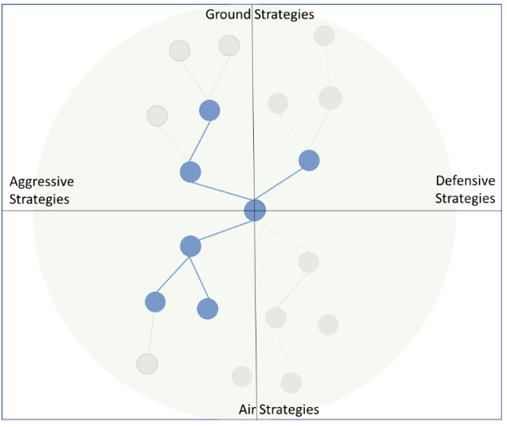
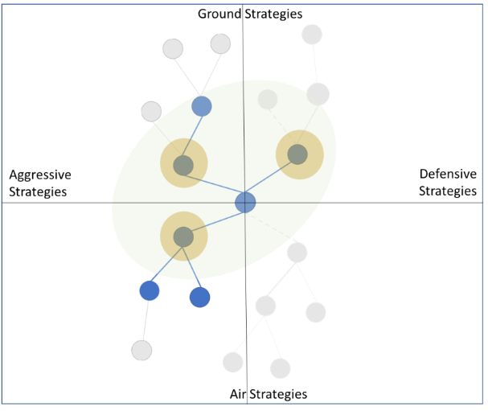
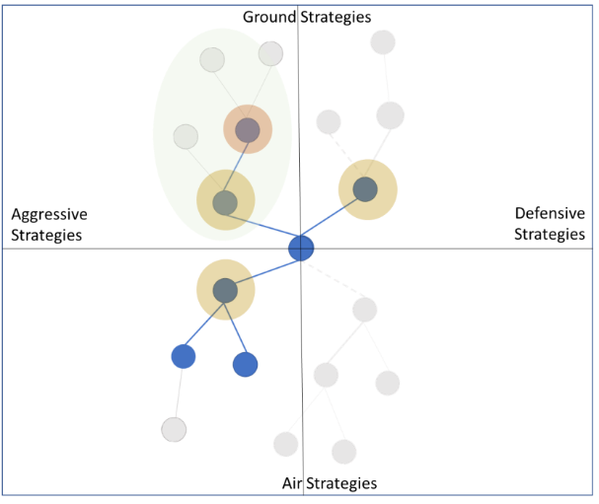

Slide 29
Experimental Design

Slide 30
Measure of Success
Test Methods:
For each unit type, generate research trees and validate
For each building type, generate research trees and validate
For each upgrade type, generate research trees and validate
For each pair of unit and building, generate research trees and validate
Target Metrics:
300 Matches with and without inference engine (enemy team set to random)
Fixed starting strategy and map selection
Compare win/loss ratio of base NOVA and inference NOVA
NOVA already wins against standard AI at ~80-90%, so I don’t expect a significant improvement
Break out by enemy race to check for variance
Measure accuracy of predictions via Jaccard index (intersection over union)

Slide 31
Results – Win Rate

Slide 32

Results – Predictive Accuracy

Slide 33
Conclusion

Slide 34
Conclusion
Details

Slide 35
References
Alberto Uriarte, S. O. (2014). Game-Tree Search over High-Level Game States in RTS Games. Retrieved from AAIDE: http://nova.wolfwork.com
Champandard, A. (2014, August 12). Monte-Carlo Tree Search in TOTAL WAR: ROME II’s Campaign AI. Retrieved from Ai Game Dev: http://aigamedev.com/open/coverage/mcts-rome-ii/
He He, J. B.-G. (2016). Opponent Modeling in Deep Reinforcement Learning. arXiv:1609.05559.
J. T. Isaacs, e. a. (2014). "GPS-optimal micro air vehicle navigation in degraded environments". American Control Conference (pp. pp. 1864-1871). Portland, OR: IEEE.
K. Wendlandt, M. B. (2005). "Indoor localization with probability density functions based on Bluetooth". IEEE 16th International Symposium on Personal, Indoor and Mobile Radio Communications, Berlin, pp. 2040-2044 Vol. 3.
Laviers, K. e. (2009). Exploiting Early Intent Recognition for Competitive Advantage. Springfield, VA: KNEXUS RESEARCH CORP.
Robert Grover Brown, P. Y. (2012). EXPECTATION, AVERAGES, AND CHARACTERISTIC FUNCTION. In Introduction to Random Signals and Applied Kalman Filtering (pp. 13-18). John Wiley & Sons, Inc.
S. Venkateswaran, e. a. (2013). "RF source-seeking by a micro aerial vehicle using rotation-based angle of arrival estimates". American Control Conference (pp. pp. 2581-2587). Washington, DC: IEEE.
Santiago Ontañon, G. S. (2013, 5 (4)). A Survey of Real-Time Strategy Game AI Research and Competition in StarCraft. IEEE Transactions on Computational Intelligence and AI in games, IEEE Computational Intelligence Society, pp.1-19.
Uriarte, A. (2017). Adversarial Search and Spatial Reasoning in Real Time Strategy Games. Philadelphia: Drexel University.

Slide 37
Schedule
 | T1 1 2 3 4 5 6 7 8 9 10 11 12 | T2 13 14 15 16 17 18 19 20 21 22 23 24
Design
Develop
Test
Document
Design Done
Toy Demo
Software Done
Testing Done
Thesis Submission
Req
Arch
Toy Problem
Final Product
V&V for Thesis
Writing Thesis
Thesis Outline
Thesis Rev1

Slide 38
Strategies - Terran
Name | A vs AA | G vs AG | Atk vs Def
Bio (marines/medics) | -0.25 | 0.75 | 1
Rax_fe (second base) | 0 | 0 | -1
Two_facto(tanks) | 0 | 1 | 0.5
Vultures | 0 | 1 | 0.75
Air(wraiths) | 0.75 | -0.5 | 0.25
drop | 0.25 | 0.25 | -0.25

Slide 39
Strategies - Protoss
Name | A vs AA | G vs AG | Aggressive vs Def
Two_gates (zealots) | 0 | 1 | 1
fast_dt (dark templars) | -0.25 | 0 | 0
Templar | -0.5 | 0 | 0.5
Speedzeal (zealots+upgrades) | 0 | 1 | 0.75
Corsair | -1 | 0 | -0.75
Nony (dragoons) | 0 | 0 | 0.5
Reaver_drop | 0.25 | 0 | -0.25

Slide 40
Strategies - Zerg
Name | A vs AA | G vs AG | Atk vs Def
Speedlings (zerlings) | 0 | 1 | 1
Fast_mutas (mutalisks) | 1 | -1 | 0.25
Mutas (expand+mutas) | 0.75 | -0.75 | -0.25
Lurkers | 0 | 0 | -0.25
Hydras | -0.25 | 1 | 0.75

